Slide 1
Section 5.5
Applications of Definite Integrals

Slide 2
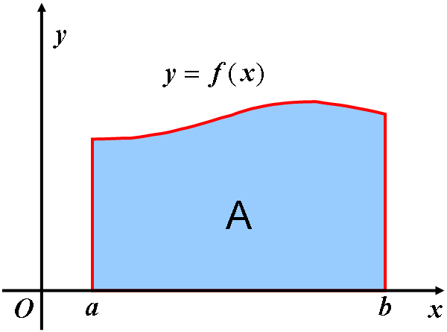

Method of elements for setting up integral representations
Many quantities we want to know in science and technology can be calculated
by definite integrals.
Questions:
What kind of quantities can be calculated by definite integrals?
How can we set up the integral representations?

Slide 3
Method of elements for setting up integral representations
We had seen that the area of trapezoid with curved top, the mass of a stick
and the displacement of a movement along a straight line can all be
expressed by definite integrals. They both have the following properties.
1) They are all distributed non-uniformly but continuously on an interval [a,b]
2) These quantities are all additive, that is, the total quantity on the interval
[a,b] equals the sum of all those local quantities distributed on the subintervals
of [a,b].
In general, a quantity with these two characteristics may be calculated by a
definite integral.
We will revisit the process, which we used to determine the area of a trapezoid
with curved top, to illustrate that how we can setting up integral representations.

Slide 4
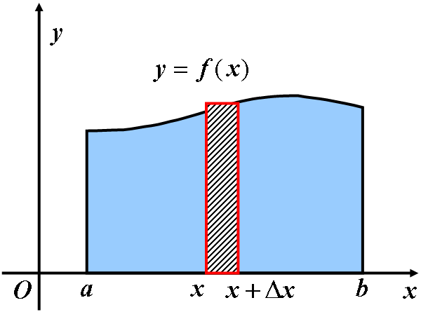
Method of elements for setting up integral representations
In order to calculate the whole area, we will first find the approximate value of
every local area. To do this, we need two steps:
(1) “partition” Divide [a,b] into many very small subintervals;
(2) “homogenization” Regard the local area distributed on each small
interval [x,x+Δx] as a rectangle with height f(x). Using multiplication
for the uniform distribution, we have

Slide 5
Method of elements for setting up integral representations
After we found the approximation value of every local area, we can easily obtain
the precise value of the whole area A by the other two steps:
(3) “summation”
(4) “precision”
Because the function f(x) is continuous on [a,b], the limit of the sum is just the
definite integral.

Slide 6
Method of elements for setting up integral representations
By the geometric meaning of the definite integral with varying upper limit, we
known that the area of the definite integral with the curve y = f(x) and on the
Interval [a,x] is expressed by , namely
So the local area is just the increment of this function. Since
the approximate value of the local area , is actually the differential
of the function (1).

Slide 7
Method of elements for setting up integral representations
In general, the procedures may be simplified into the following two steps:
(1) Find the element Find the approximate value of the local required
quantity, dQ, on the subinterval
(2) Setup the integration For the differential , write down the
corresponding definite integral over the interval , we obtain
Infinitesimal element of the integral or element of the integral
The procedure summarized by the above two steps is called the element method
of integration.

Slide 8
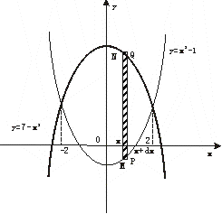
Some examples on the applications of the definite integral in geometry
Example 1
Find the area A of the region enclosed by the parabolas
and
Solution
From the system
we can easily obtain the abscissae of the
intersections of the two parabolas,
It is easy to see that the area A is distributed continuously but non-uniform on the interval [-2,2], and is additive.
Thus we may calculate it by an integration.

Slide 9
Some examples on the applications of the definite integral in geometry
Example 1
Find the area A of the region enclosed by the parabolas
and
Solution (continued)
By the method of element, we calculate A by two steps:
(1) Find the element
Partition the interval [-2,2] and consider the subinterval [x, x + dx].
On this subinterval, the area distributed non-uniformly may be regarded approximately as uniform, that is a rectangle with height
Thus, we obtain the element of area:

Slide 10
Some examples on the applications of the definite integral in geometry
Example 1
Find the area A of the region enclosed by the parabolas
and
Solution (continued)
(2) Setup the integral
The whole area A is just the integral of the element
over the interval [-2,2] .
So
Finish.

Slide 11
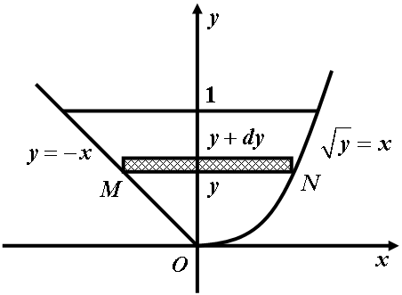
Some examples on the applications of the definite integral in geometry
Example 2
Find the area A of the region enclosed by the parabola
and the straight lines
Solution
This area A may be regarded as a
quantity which is distributed non-
uniformly on the interval [0,1] on
the y-axis.
To find the element of the area,
partition the interval [0,1], and
consider the subinterval, regarding
as the area of a rectangle with width

Slide 12
Some examples on the applications of the definite integral in geometry
Example 2
Find the area A of the region enclosed by the parabola
and the straight lines
Solution (continued)
Then the element of the area is
Hence, the total area is
Finish.

Slide 13
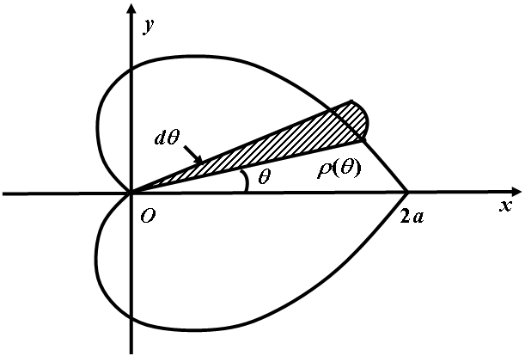
Some examples on the applications of the definite integral in geometry
Example 3
Find the area A of the region enclosed by the cardioid
Solution
By the symmetry of the graph of the cardioid, it is enough to calculate the area located in the upper half-plane.
Since the equation of the cardioid is expressed in polar coordinates, the area may be regarded as a distribution on the interval [0,π] and the distribution is non-uniform.

Slide 14
Some examples on the applications of the definite integral in geometry
Example 3
Find the area A of the region enclosed by the cardioid
Solution (continued)
To calculate the area, we partition
the interval [0,π] and consider the
subinterval
On this interval, we regard as
A constant . Thus the element
of area is

Slide 15
Some examples on the applications of the definite integral in geometry
Example 3
Find the area A of the region enclosed by the cardioid
Solution (continued)
Thus, the total area is
Finish.

Slide 16
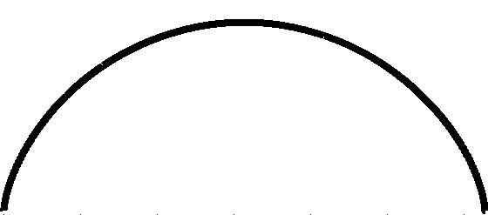
Some examples on the applications of the definite integral in geometry
Example 4
Find the area A of the region enclosed by the curve
y
and the x-axis.
Solution
O
x

Slide 17
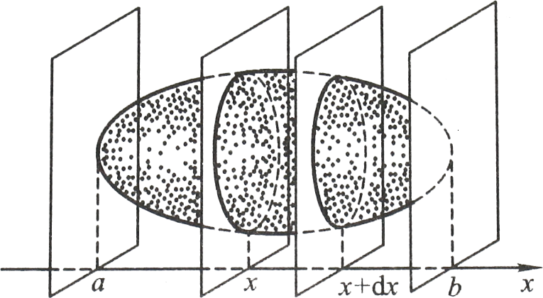
Some examples on the applications of the definite integral in geometry
Example 5
Consider a solid like the one shown in the following figure. At
each the cross section of the solid is a region whose area is a known
continuous function . Express the volume of this solid by an integration.
Solution
(1) Find the element of the volume.
We partition [a,b] so that the solid
can be cut into many slices by
perpendicular planes through the
Points of the partition.
Consider the slice corresponding to
the subinterval .We have
the element of volume

Slide 18
Some examples on the applications of the definite integral in geometry
Example 5
Consider a solid like the one shown in the following figure. At
each the cross section of the solid is a region whose area is a known
continuous function . Express the volume of this solid by an integration.
Solution (continued)
(2) Setup the integration.
By the method of elements we
obtain the volume of the given solid as follows

Slide 19
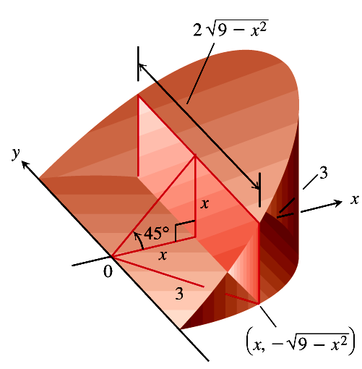
Some examples on the applications of the definite integral in geometry
Example 6
A curved wedge is cut from a cylinder of radius 3 by two planes.
One plane is perpendicular to the axis of the cylinder. The second plane crosses
the first plane at a 45º angle at the center of the cylinder. Find the volume of the
wedge.
Solution
(1) A sketch.
We draw the wedge and sketch a typical
cross section perpendicular to the x-axis.
(2) The formula for A(x).
The cross section at x is a rectangle of area

Slide 20
Some examples on the applications of the definite integral in geometry
Example 6
A curved wedge is cut from a cylinder of radius 3 by two planes.
One plane is perpendicular to the axis of the cylinder. The second plane crosses
the first plane at a 45º angle at the center of the cylinder. Find the volume of the
wedge.
Solution (continued)
(3) The limits of integration.
The rectangles run from to
(4) Integrate to find the volume.
Finish.

Slide 21
Some examples on the applications of the definite integral in geometry
The most common application of the method of slicing is to solids of revolution. Solids of revolution are solids whose shapes can be generated by revolving plane Regions about axes. The only thing that changes when the cross sections are circular is the formula for the area A(x).
The typical cross section of the solid perpendicular to the axis of revolution is a disk of radius R(x) and area
For this reason, the method is often called the disk method.
Here are some Examples.

Slide 22
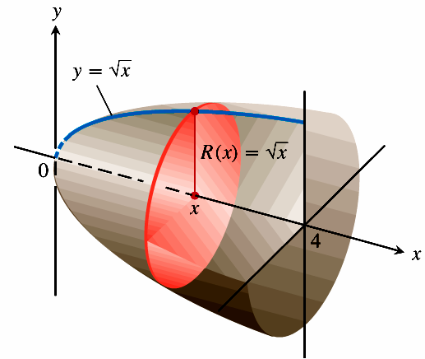
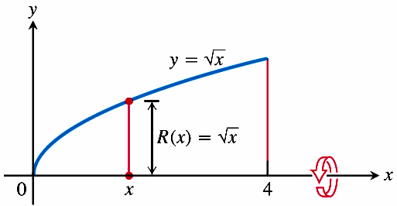
Some examples on the applications of the definite integral in geometry
Example 7
The region between the curve , and the x-axis
is revolved about the x-axis to generate a solid. Find its volume.

Slide 23
Some examples on the applications of the definite integral in geometry
Example 7
The region between the curve , and the x-axis
is revolved about the x-axis to generate a solid. Find its volume.
Solution
We draw figures showing the region,
a typical radius, and the generated solid.
The volume is
Finish.

Slide 24
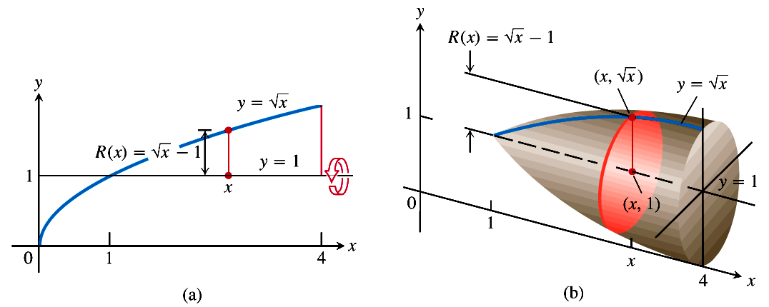
Some examples on the applications of the definite integral in geometry
Example 8
Find the volume of the solid generated by revolving a region
bounded by and the lines , about the line .

Slide 25
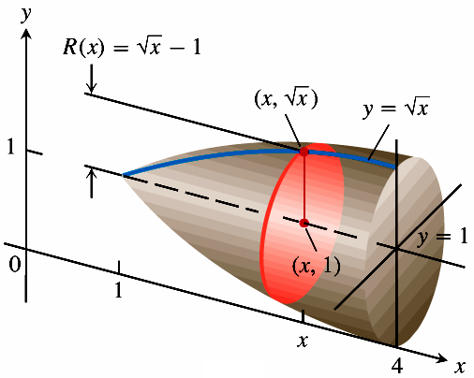
Some examples on the applications of the definite integral in geometry
Example 8
Find the volume of the solid generated by revolving a region
bounded by and the lines , about the line .
Solution
We draw figures showing the region,
a typical radius, and the generated solid.
The volume is
Finish.

Slide 26
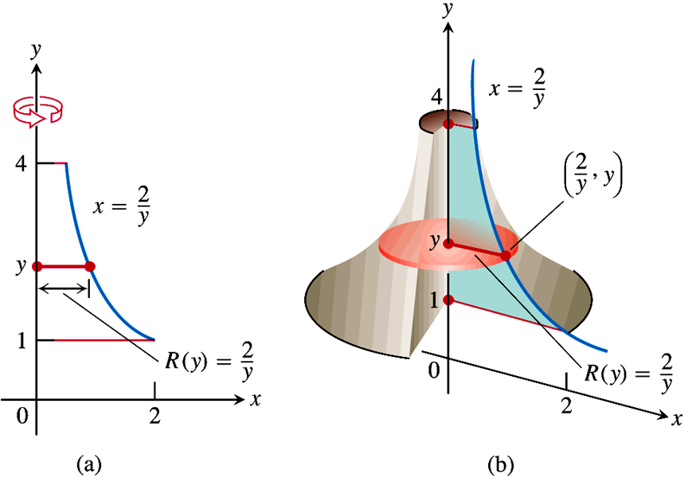
Some examples on the applications of the definite integral in geometry
Example 9
Find the volume of the solid generated by revolving a region
between the y-axis and the curve , , about the y-axis.

Slide 27
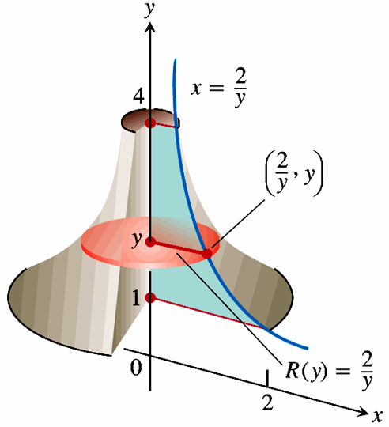
Some examples on the applications of the definite integral in geometry
Example 9
Find the volume of the solid generated by revolving a region
between the y-axis and the curve , , about the y-axis.
Solution
We draw figures showing the region,
a typical radius, and the generated solid.
The volume is
Finish.

Slide 28
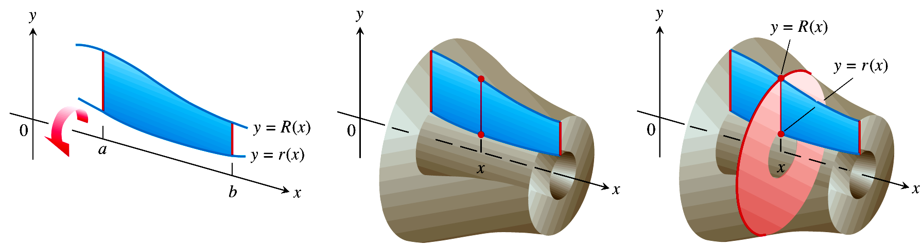
Some examples on the applications of the definite integral in geometry
If the region we revolve to generate a solid does not border on or cross the axis
of revolution, the solid has a hole in it. The cross sections perpendicular to the
axis of revolution are washers instead of disks.
The dimensions of a typical washer are
Outer radius:
Inner radius:
The washer’s area is

Slide 29
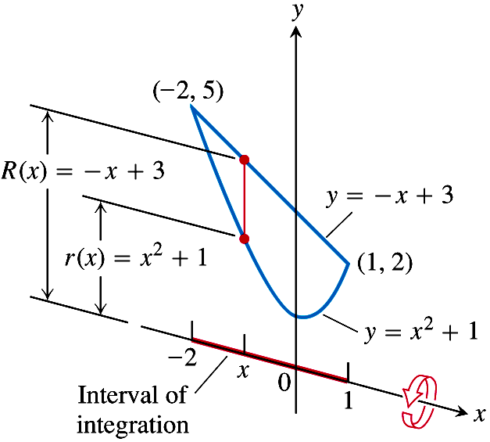
Some examples on the applications of the definite integral in geometry
Example 10
The region bounded by the curve and the line
is revolved about the x-axis to generate a solid. Find the volume
of the solid.
Solution
Step 1.
Draw the region and sketch
a line segment across it perpendicular
to the axis of revolution.

Slide 30
Some examples on the applications of the definite integral in geometry
Example 10
The region bounded by the curve and the line
is revolved about the x-axis to generate a solid. Find the volume
of the solid.
Solution (continued)
Step 2.
Find the limits of integration
by finding the x-coordinates of the
intersection points of the curve and
the line in right figure.

Slide 31
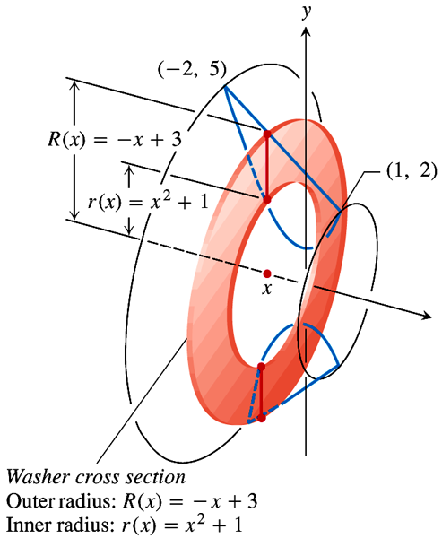
Some examples on the applications of the definite integral in geometry
Example 10
The region bounded by the curve and the line
is revolved about the x-axis to generate a solid. Find the volume
of the solid.
Solution (continued)
Step 3.
Find the outer and inner radii of the washer that would be swept out by the line segment if it were revolved about the x-axis along with the
region.
Outer radius:
Inner radius:

Slide 32
Some examples on the applications of the definite integral in geometry
Example 10
The region bounded by the curve and the line
is revolved about the x-axis to generate a solid. Find the volume
of the solid.
Solution (continued)
Step 4. Evaluate the volume integral.
Finish.

Slide 33
Some examples on the applications of the definite integral in geometry
Example 11 Find the arc length of the following plane curves

Slide 34
Some examples on the applications of the definite integral in geometry
Example 12 Find the arc length of the following plane curves

Slide 35
Some examples on the applications of the definite integral in physics
Pumping Liquids from Containers
How much work does it take to pump all or part of the liquid from a container?
To find out, we imagine lifting the liquid out one thin horizontal slab at a time and applying the equation W = Fd to each slab, where F is the force and d is the distance of the object along with the direction of F. We then evaluate the integral this lead to as the slabs become thinner and more numerous. The integral we get each time depends on the weight of the liquid and the dimensions of the container, but the way we find the integral is always the same.

Slide 36
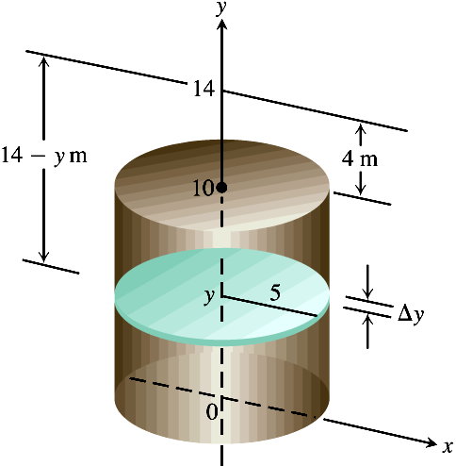
Some examples on the applications of the definite integral in physics
Example 13
How much work does it take to pump the water from a full
upright circular cylindrical tank of radius 5m and height 10m to a level of 4m
above the top of the tank?
Solution
We draw the tank as right figure, add
coordinate axes, and imagine the water
divided into thin horizontal slabs by plans
perpendicular to the y-axis at the points of
a partition P of the interval [0,10].

Slide 37
Some examples on the applications of the definite integral in physics
Example 13
How much work does it take to pump the water from a full
upright circular cylindrical tank of radius 5m and height 10m to a level of 4m
above the top of the tank?
Solution (continued)
The typical slab between the planes at y and
has a volume of
The force F(y) required to lift the slab is equal
to its weight,

Slide 38
Some examples on the applications of the definite integral in physics
Example 13
How much work does it take to pump the water from a full
upright circular cylindrical tank of radius 5m and height 10m to a level of 4m
above the top of the tank?
Solution (continued)
The distance through which F must act is
about (14 - y)m, so the work done lifting
the slab is about

Slide 39
Some examples on the applications of the definite integral in physics
Example 13
How much work does it take to pump the water from a full
upright circular cylindrical tank of radius 5m and height 10m to a level of 4m
above the top of the tank?
Solution (continued)
The work it takes to lift all the water is
approximately
This is a Riemann sum for the function
over the interval
The work of pumping the tank
dry is the limit of these sums.

Slide 40
Some examples on the applications of the definite integral in physics
Example 13
How much work does it take to pump the water from a full
upright circular cylindrical tank of radius 5m and height 10m to a level of 4m
above the top of the tank?
Solution (continued)
Finish.

Slide 41
Review
The applications of the definite integral in geometry
The area of a plane figure
The volume of the solid with known cross sections
The volume of revolution solids
The applications of the definite integral in physics

